Slide 1
36666666666666666666666666666666666666666666666666666666666666666666666666666666666666666666666666666666666666666666666666
++
MRI(Magnetic Resonance Imaging)
Radiation Safety (SEC)
SUBJECT CODE – PHYS307TH

Slide 2
Magnetic Resonance Imaging (MRI)
It is not possible to see the internal organs and structure of the human body directly to locate the infection or illness . Magnetic resonance imaging (MRI) is a spectroscopic imaging technique used in medical setting to produce image of the internal structure of the human body. The scan uses a strong magnetic field and radio waves to generate images of internal parts ( cells, tissues , organs ) of the body that can't be seen as well with X-rays , CT scans or ultrasounds . For example , it can help doctors to see inside joints , cartilage , ligaments , muscles and tendons , which make it helpful for detecting various sports injuries. It is also used to examine internal body structures and diagnose a variety of disorders , such as strokes, tumors , aneurysms , spinal cord injuries , multiple sclerosis and eye or inner ear problems. It is also widely used in research to measure brain structure and their function.

Slide 3
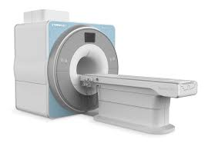
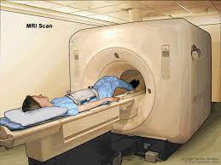
Principal of MRI
MRI is a spectroscopic technique used to obtained microscopic chemical and physical data of molecules based on the principal of nuclear magnetic resonance (NMR) which is the interplay of spin and resonance . Therefore it is also known as nuclear magnetic resonance imaging.

Slide 4
MRI Machine
The schematic diagram of operational MRI machine and its cutway is shown . The components of a MRI machine are a magnet which produces a very powerful uniform magnetic field , Gradient Magnets which are much lower in strength , Equipment to transmit radio frequency (RF) and a very powerful computer system , which translates the signals transmitted by the coils. The most important component of the MRI scanner is the magnet . The magnets currently used in scanners today are in the 0.5 tesla to 2.0 tesla range ( 5,000 to 20,000 gauss) . Higher values are used for research . Three types of magnets are used in MRI systems , Resistive magnets , Permanent magnets ; Super conducting magnets ( the most commonly used type in MRI scanners ). In addition to the main magnet , the MRI machine also contains three gradient magnets . These magnets have a much lower magnetic field and are used to create a variable field .

Slide 5
Procedure to take MRI scan
Procedure to take MRI scan : During an MRI , a person will be asked to lie on a movable table that will slide into a doughnut-shaped opening of the machine to scan a specific portion of body . The machine itself will generate a strong magnetic field around the person and radio waves will be directed at the body . A person will not feel the magnetic field or radio waves , so the procedure itself is painless . However , there may be a lot of loud thumping or tapping noises during the scan . Some people may be given a contrast solution by intravenous , a liquid dye that can highlight specific problems that might not show up otherwise on the scan . People who feel claustrophobic in enclosed places may be given sedating medication to help them relax or fall asleep during the scan because it is important to stay as still as possible to get clear images. Movement can blur the images . Some hospitals might have an open MRI machine that is open on the sides rather than the tunnel-like tube found in a traditional machine . This may be a helpful alternative for people who feel afraid of confined spaces . The scan itself may take 30 to 60 minutes , on average . A radiologist will look at the images and send a report to the doctor .

Slide 6
Physics of MRI
The physics of MRI is the interplay of magnetism and resonance . The magnetic resonance imaging is accomplished through the absorption and emission of energy of the radio frequency (RF) range of the electromagnetic spectrum. The atoms that compose the human body have a property known a spin ( a fundamental property of all atoms in nature like mass or charge ) . Spin can be thought of as a small magnetic field and can be given a + or - sign and a mathematical value of multiples of 1/2 . Components of an atom such as protons , electrons and neutrons all have spin . Protons and neutron spins are known as nuclear spins . An unpaired component has a spin of 1/2 and two particles with opposite spins cancel one another . In nuclear magnetic resonance it is the unpaired nuclear spins that produce a signal in a magnetic field

Slide 7
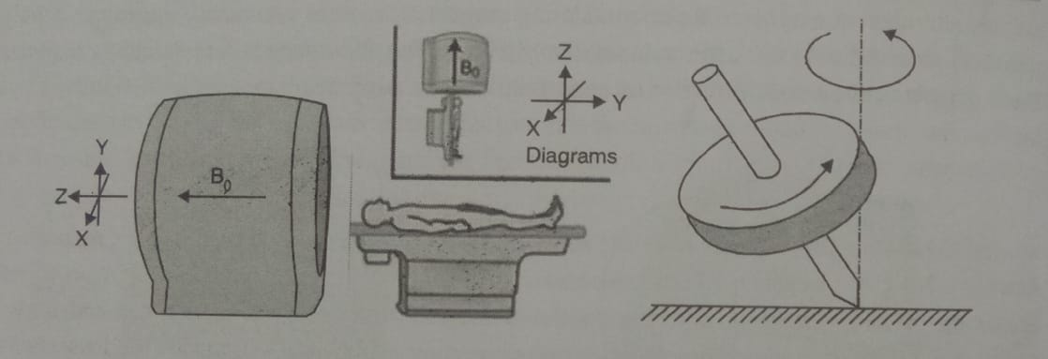
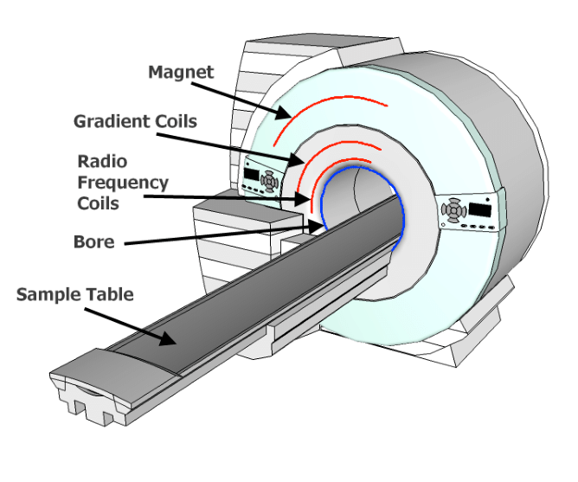
Diffusion MRI
This form of MRI measures how water molecules diffuse through body tissues. Certain disease processes such as a stroke or tumor can restrict this diffusion , so this method is often used to diagnose them

Slide 8
Functional MRI
In addition to structural imaging , MRI can also be used to visualize functional activity in the brain . It is used to observe brain structures and to determine which parts of the brain are handling critical functions . It may also be used to evaluate damage from a head injury or Alzheimer's disease. It has been especially useful in neuroscience. It has really revolutionized how we study the brain.

Slide 9
MRI Safety
Unlike other imaging forms like X- rays or CT scans , MRI doesn't use ionizing radiation. MRI is increasingly being used to image fetuses during pregnancy , and no adverse effects on the fetus have been demonstrated . Still , the procedure can have risks , and medical societies don't recommend using MRI as the first stage of diagnosis. Because MRI uses strong magnets , any kind of metal implant , such as a pacemaker , artificial joints , artificial heart valves, cochlear implants or metal plates , screws or rods , pose a hazard . The implant can move or heat up in the magnetic field . Several patients with pacemakers who underwent MRI scans have died , patients should always be asked about any implants before getting scanned . The constant flipping of magnetic fields can produce loud clicking or beeping noises , so ear protection is necessary during the scan.

Slide 10
REFERENCE
Radiology and Safety by Ashok Sharma and Dr. Hemant Pal
More preference to google

